Slide 1
To build out a web service and deploy your model as a service
Team 12:
Priti Agarwal
Yalin Li
Zhi Li

Slide 2
To build out a web service and deploy your model as a service
Regression model:
Linear Regression
Decision Forest
Decision Tree
Neural Network
Classification model:
Logistic Regression
Decision Forest
KNN
Neural Network
Clustering model:
K-means
Hierarchical

Slide 3
Create the rest API and the web application to invoke the rest API
Tool used: Microsoft Visual Studio 2015
Language used: C#
Web technology used: asp.net, html, CSS
Create HttpClient object.
Set-up the input message by copying the input-json body and replacing the input values with the values obtained from UI.
Set the Authorization header based on the api key: “Bearer” + apikey
Setup the client base address
Call REST API and retrieve the response client using ‘await’
If the response is a success code, then store the result.
If the response is an error code, then show the error.
http://adsassignment3.azurewebsites.net/

Slide 4
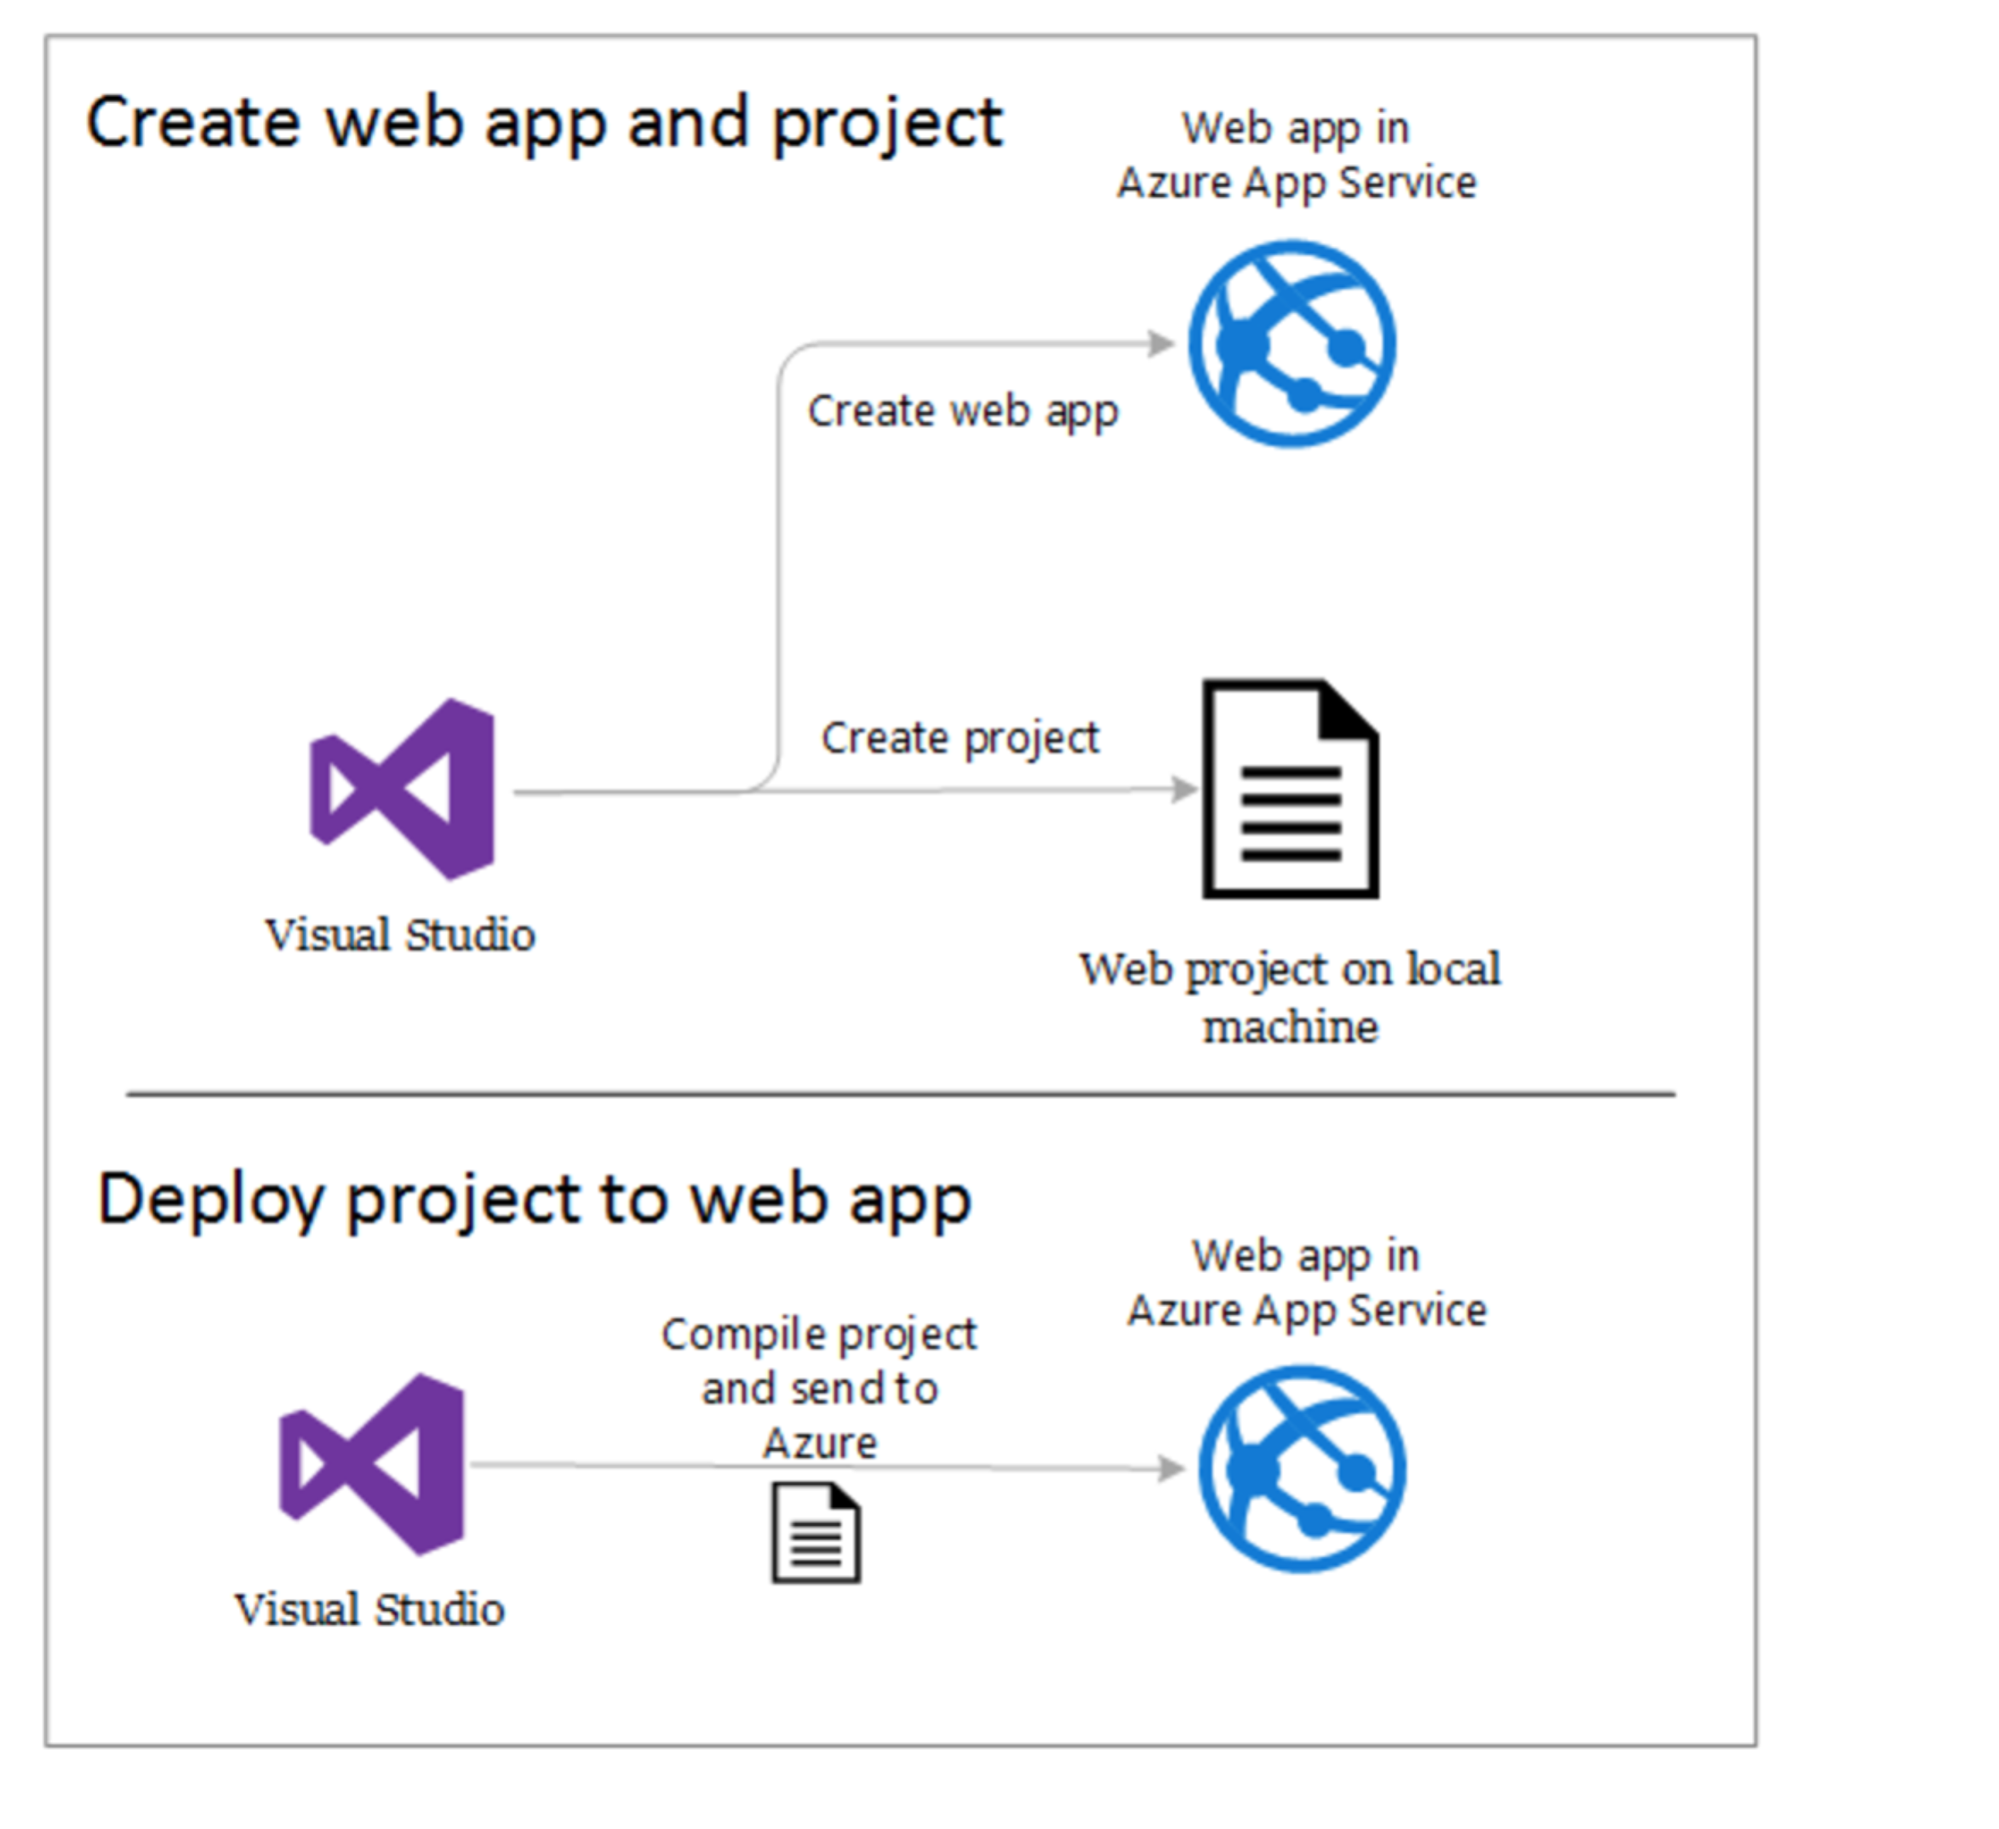
Deploy an ASP.NET web app to Azure App Service, using Visual Studio:

Slide 5
Distribution:
Models and deploy as a service: Zhi, Priti, Yalin
Report: 8 models, Invoke service from Rest (Priti), 2 models(Zhi)
UI – Zhi
Invoke Service for all models – Yalin
Base C# code to invoke services - Priti
Regression Module – Priti (Backend + frontend)

Slide 6
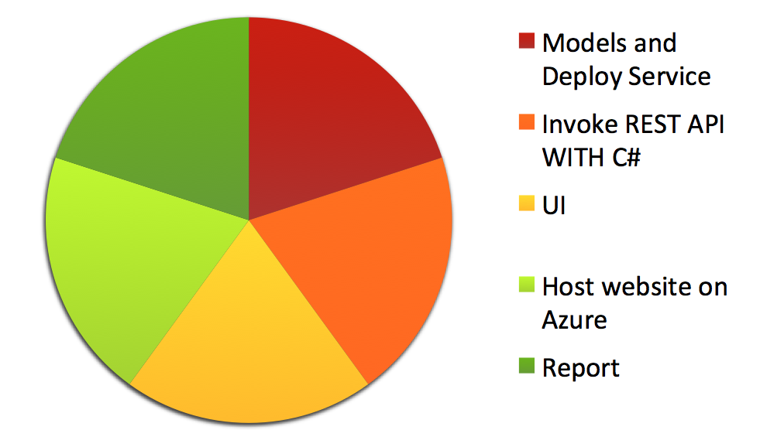
Pie Chart:
Priti, Zhi
Yalin, Zhi, Priti
Yalin, Priti
Yalin, Priti
Zhi

Slide 7
Q/A

